Slide 1
Fast Checkout Solutions
Exploring methods to streamline supermarket billing and enhance customer experience.

Slide 2
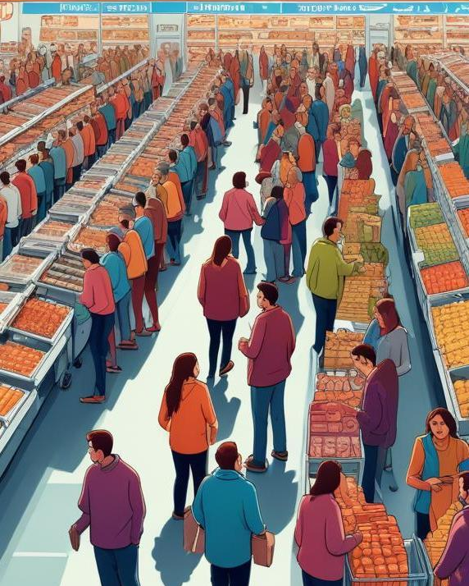
Introduction
Long queues at supermarket billing counters create a frustrating shopping experience for customers. In this presentation, we will explore the key issues causing these delays and discuss effective strategies to implement fast, cashless, and contactless shopping systems.

Slide 3
01
Current Issues

Slide 4
Long queues and customer frustration
Supermarket customers often face long waits at billing counters, leading to dissatisfaction and a negative shopping experience. These delays are exacerbated during peak hours when shopper volume increases.

Slide 5
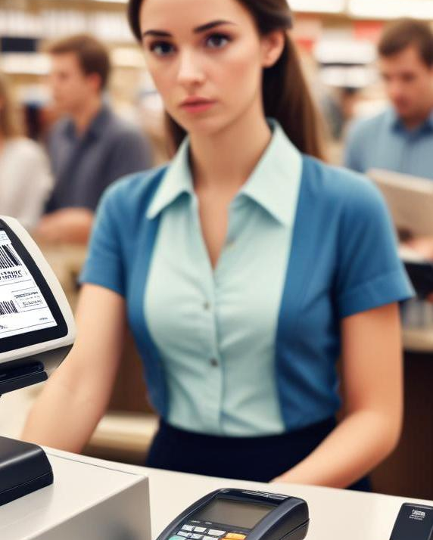
Inefficiencies in traditional barcode scanning
Traditional barcode scanning methods can be slow and prone to errors, causing further delays at the checkout process. This inefficiency discourages customers and impacts overall sales.

Slide 6
Impact on sales and customer satisfaction
Long wait times at checkout can lead to abandoned carts and a loss of sales for retailers. Customers who experience frustration often choose not to return, directly impacting customer loyalty and satisfaction.

Slide 7
02
Proposed Solutions

Slide 8
Implementation of cashless payment systems
Retailers can reduce checkout times by adopting cashless payment systems, allowing customers to pay using mobile wallets or credit cards. This speeds up transactions and minimizes the need for physical cash handling.

Slide 9

Integration of mobile scanning technologies
By enabling customers to scan items with their smartphones as they shop, retailers can streamline the checkout process. Mobile scanning allows for quicker payment and minimizes the time spent waiting in line.

Slide 10
Enhancing customer experience through contactless options
Implementing contactless payment options enables customers to complete transactions quickly without the need to physically interact with payment terminals. This solution not only speeds up the checkout process but also promotes a sense of safety and convenience.

Slide 11
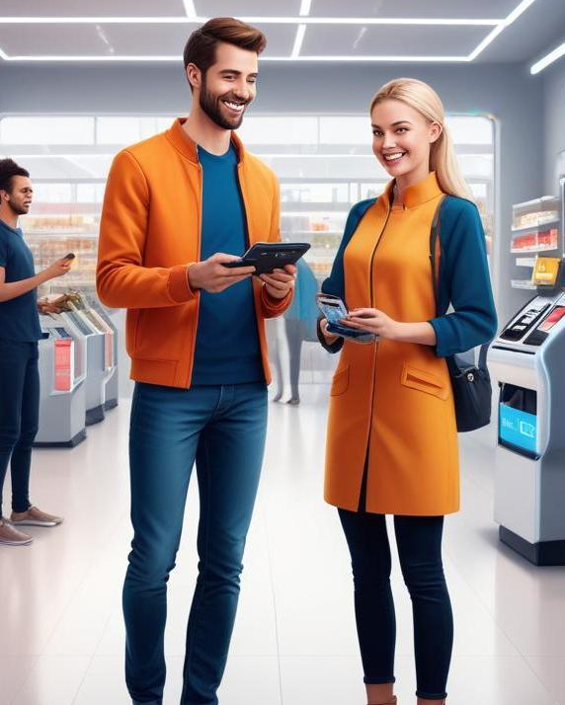
Conclusions
To address the issues of long queues and improve the overall shopping experience, retail stores must embrace fast, cashless, and contactless technologies. These solutions not only enhance customer satisfaction but also drive sales.

Slide 12
Thank you!
Do you have any questions?
+91 620 421 838

